Slide 1

Realizable Accessibility: Evaluating the Reliability of Public Transit Accessibility using High-resolution Real-time Data
Luyu Liu, Adam Porr, Harvey J. Miller
Department of Geography
The Ohio State University
(liu.6544@osu.edu, porr.4@osu.edu, miller.81@osu.edu)
2022/2/28

Slide 2
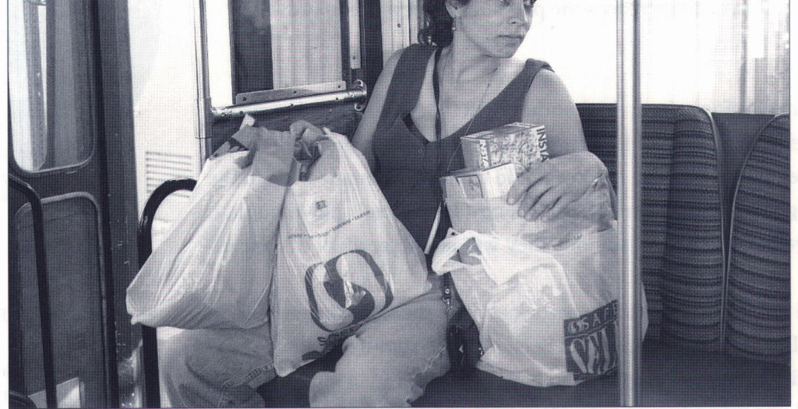
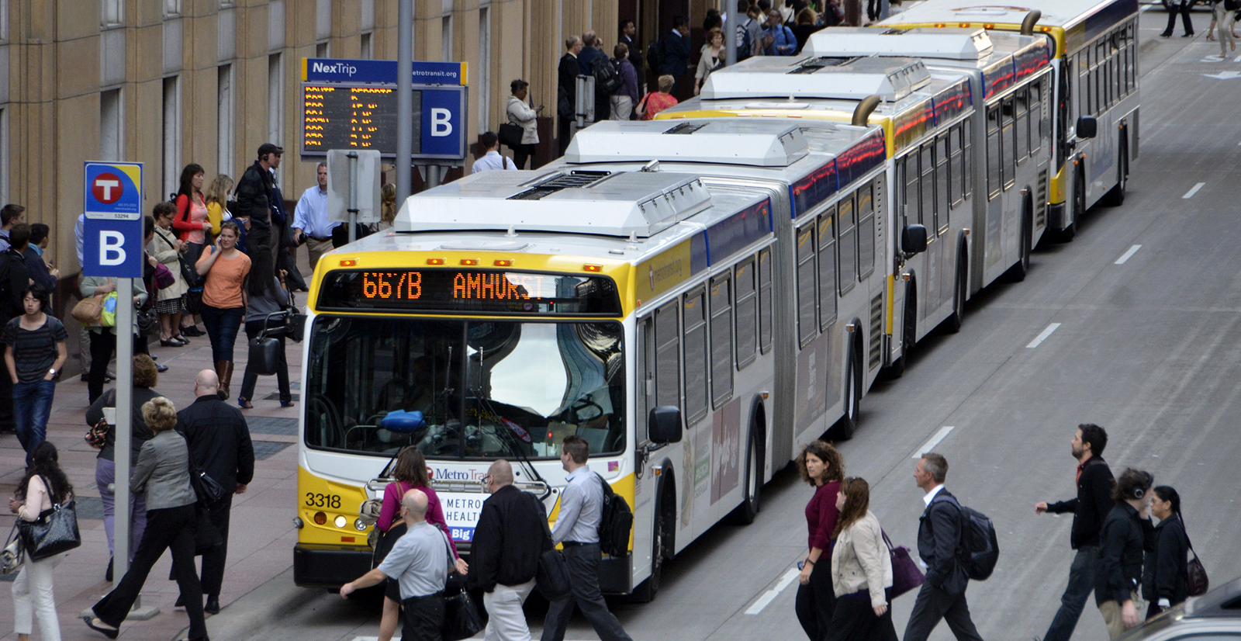

Accessibility and Public Transit
Accessibility is your ability to reach different places
Higher accessibility means more opportunities
Employments
Healthcare
Food
Accessibility via public transit can be limited due to limits on routes and schedules
Picture source

Slide 3
Evolution of Public Transit Accessibility
Early models are simplistic and static
Simple assumptions: e.g., walking accessibility to bus stops
Based on general system behavior: e.g., static headways
Cannot capture travelers’ behaviors
Accessibility is heterogeneous and dynamic
Access to different opportunities
With actual network and timetable
Better data, better measurements
High-resolution schedule: GTFS static
Large-volume real-time data: GTFS real-time

Slide 4
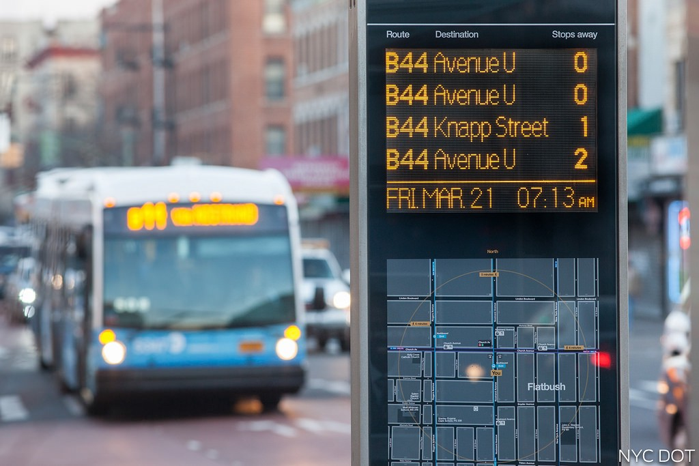
Accessibility and Scheduled Data
Most accessibility studies use scheduled data
Scheduled data is not reliable
Expected/scheduled time
Delay: traffic, weather, random disturbances
Real-time data is more reliable
Actual arrival time
What users experience
Source

Slide 5
Retrospective Accessibility
Wessel, Allen, Farber (2017) and Wessel and Farber (2019) introduced retrospective real-time accessibility
Retrospective: calculate accessibility based on historical actual arrival time
It is significantly different from the scheduled-based accessibility
But it assumes clairvoyance or perfect real-time information
No one can tell buses’ actual arrival time before taking the bus
Some maneuvers are possible retrospectively, but normal passengers cannot foresee it
It’s like buying lottery when you already know the number

Slide 6
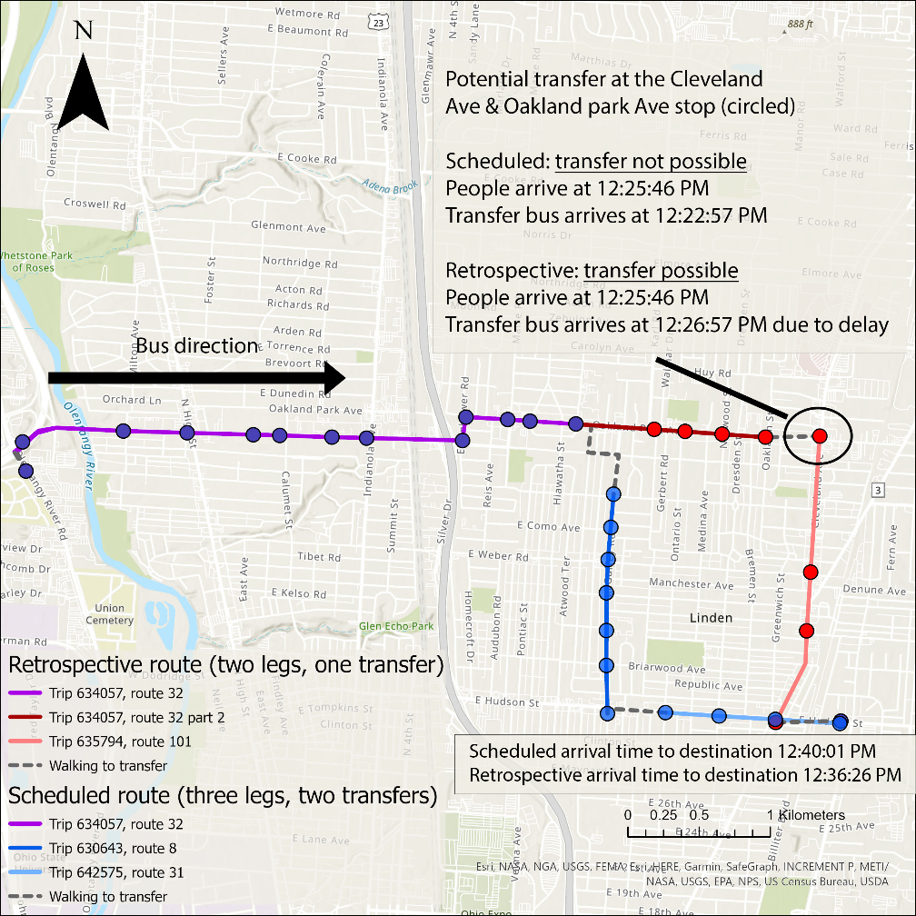
Example: Overestimation of Transfers
A physically impossible transfer became possible due to a delayed receiving bus
Only possible for scientists with historical data
Still impossible to predict and implement for ordinary passengers

Slide 7
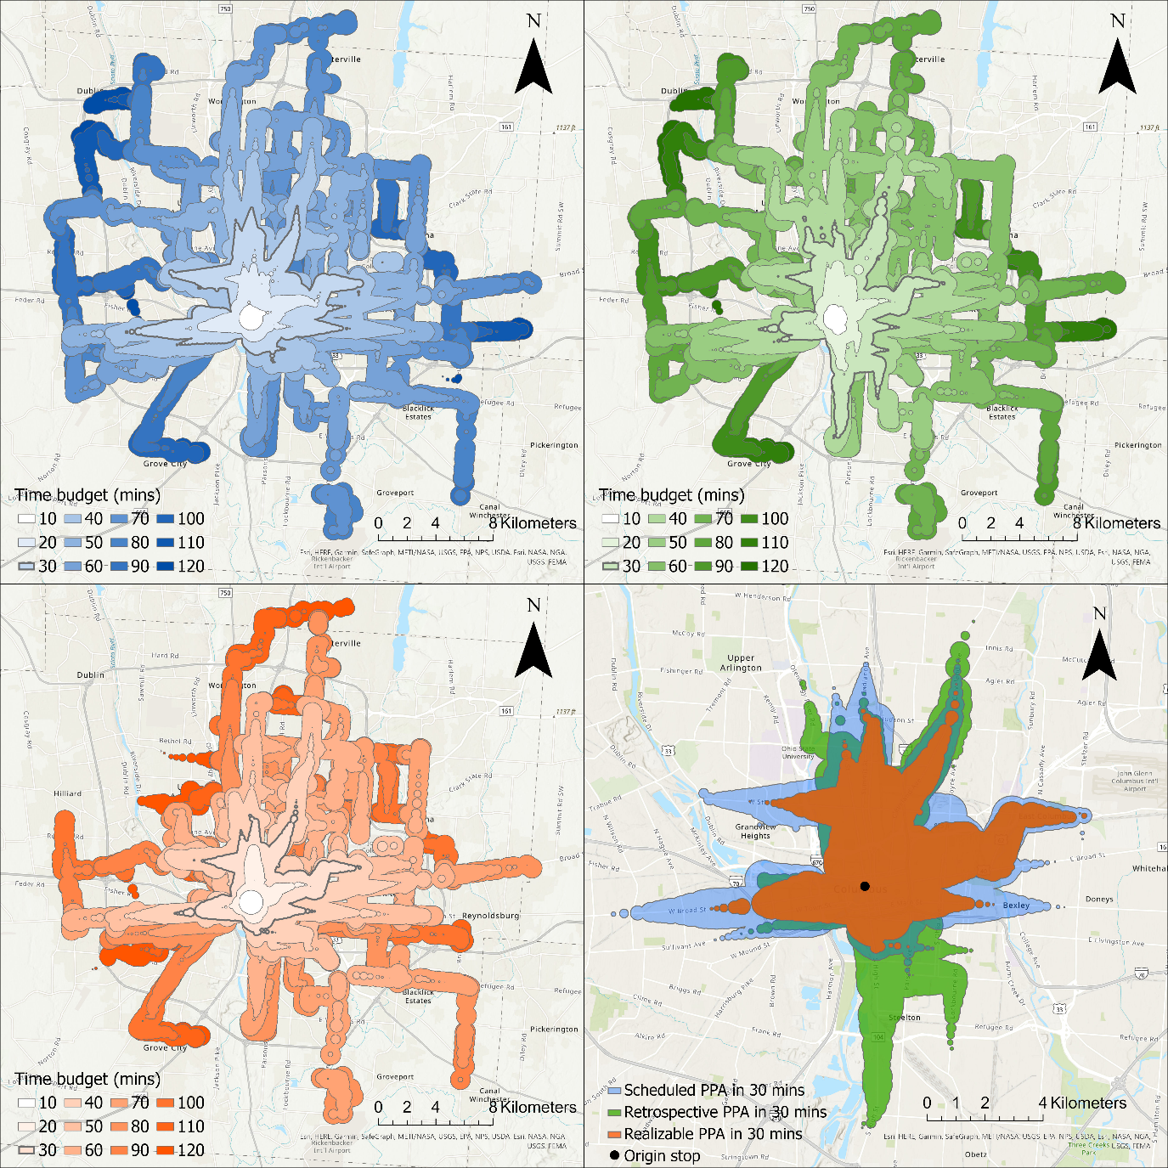
Realizable accessibility
Two step behavioral process
First plan with scheduled times, which are available beforehand.
Then implement with actual times.
Just like what humans do
More conservative
Example: realizable accessibility has smallest reachable area in 30 minutes

Slide 8
Three scenarios
Blue: scheduled, expectation from public authorities
Green: retrospective, overestimation by scientists
Orange: realizable, reality of passengers

Slide 9
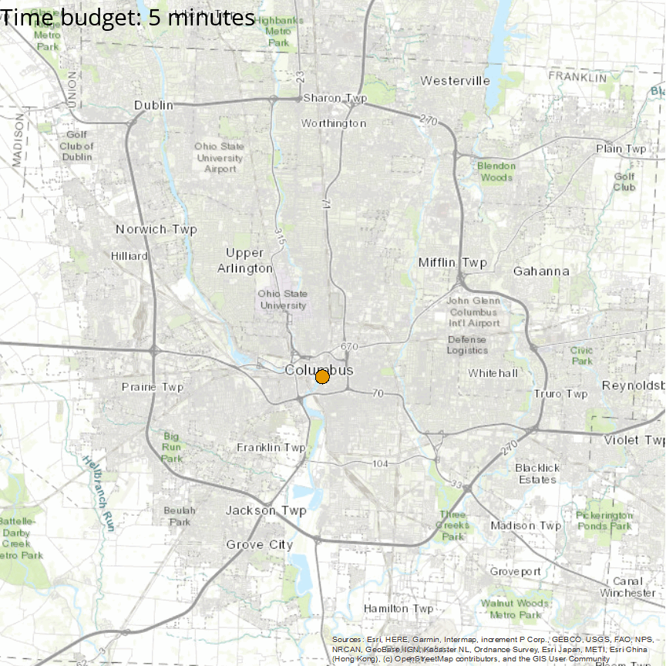
How unreliable is public transit?
Unreliability: the difference between realizable and scheduled accessibility
It is the degree of broken promise
Example: How far you can go from Columbus downtown in the real world (orange) versus in the schedule (blue)

Slide 10
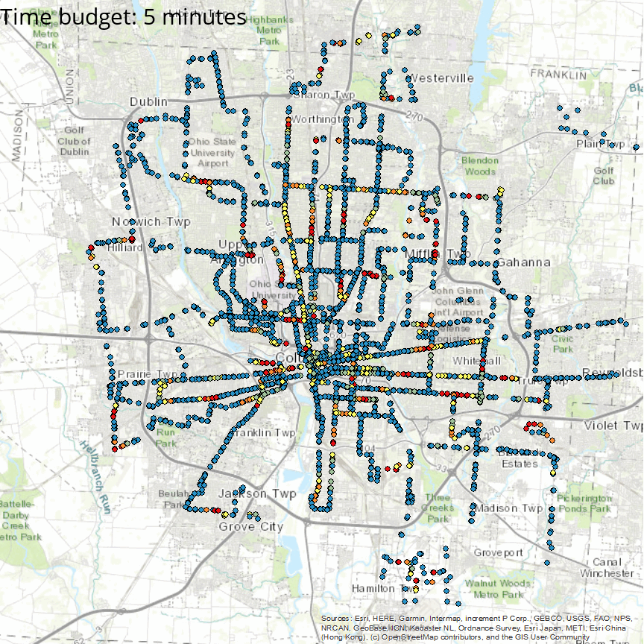
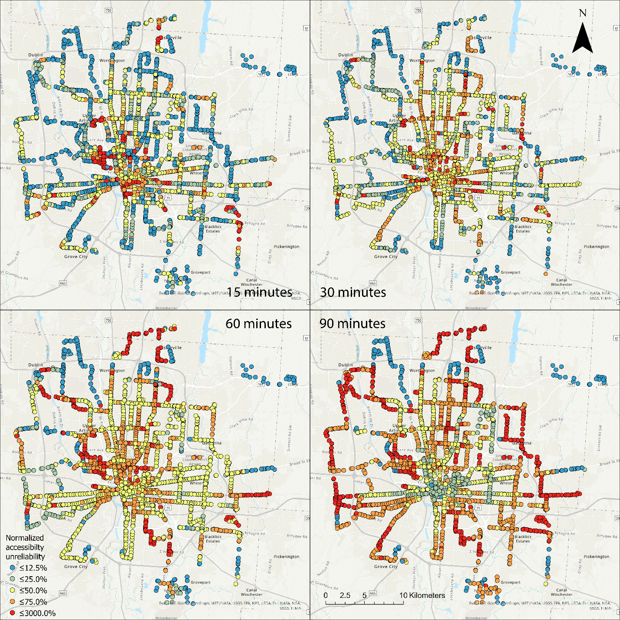
Does unreliability change over space?
Each point is a person trying to reach as far as possible
Color indicates unreliability
Blue: lower
Red: higher
For more practical time budget (15 – 30 minutes), accessibility in the city center is more unreliable

Slide 11
Spread of unreliability
Unreliability start from city center, spread to the suburban with higher time budget
Unreliability reaches saturation with long time budget
Downtown has low unreliability then
Because both scheduled and realizable can reach the city boundary
Does not mean overall unreliability is better

Slide 12
Conclusions
We often overestimate the accessibility generated by transit
We should be more conservative when planning transit systems
Transit systems should be more about humans, less about system

